Slide 1


Comprehensive Evaluation of Singing Quality
Sound & Music Computing Lab
Chitralekha Gupta
A0135979J
Supervisors: A/Prof Ye Wang & Prof. Haizhou Li
NUS Graduate School for Integrative Sciences and Engineering
Associated with School of Computing
National University of Singapore
3rd May 2019

Slide 2
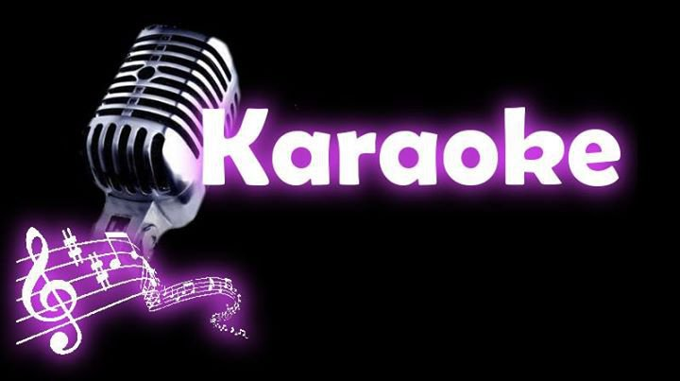
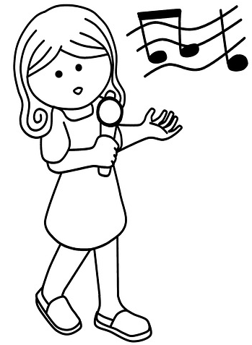
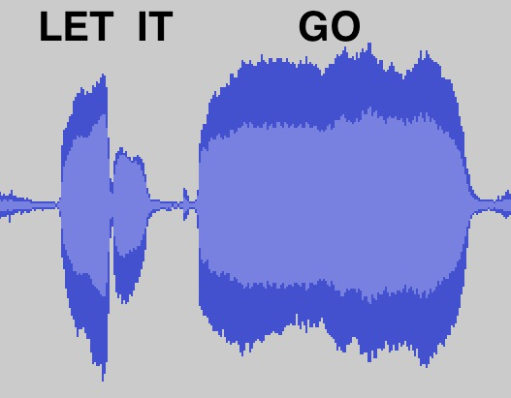

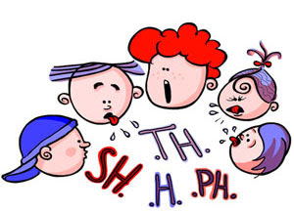
Why Singing Quality Research?
Sound & Music Computing Lab
Edutainment
Music Information Retrieval
Singing lessons and scoring
Singing-to-Text transcription
Singing-to-Lyrics alignment
Query-by-singing
Language Learning
Speech Therapy
Pronunciation Evaluation
Intelligible Song Recommendation
Music Therapy for Speech Disorders

Slide 3
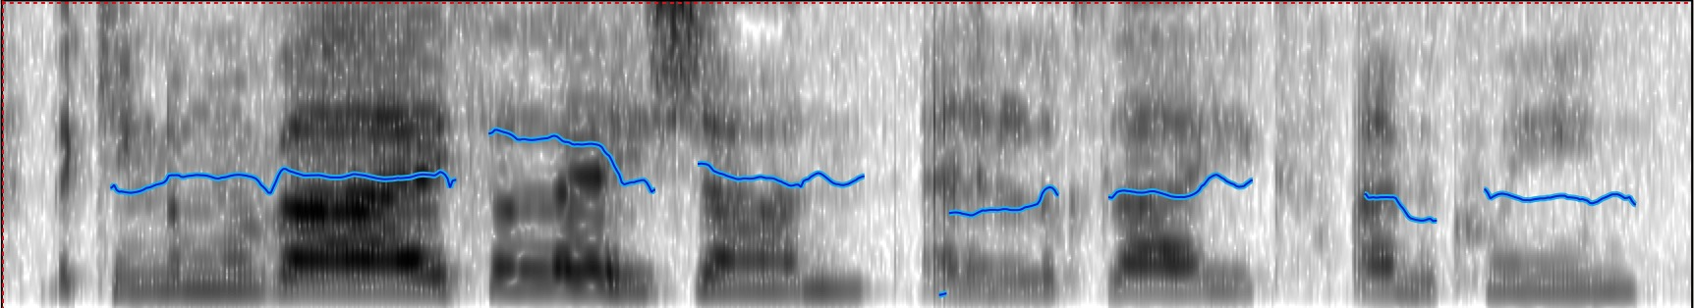

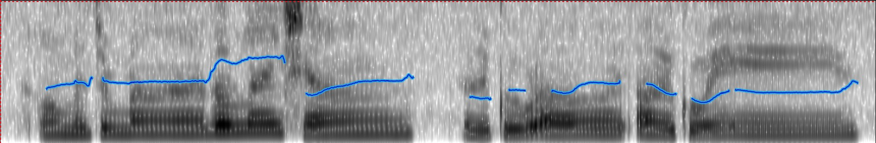
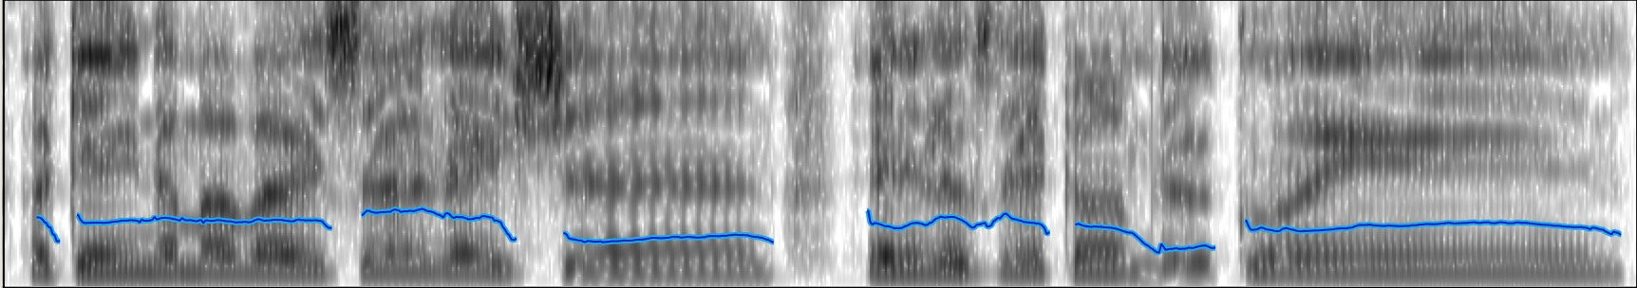
How should we characterize singing quality?
Sound & Music Computing Lab
What is the difference between these singing renditions?
Lyrics: …a kingdom of isolation, and it looks like I’m the queen
500 Hz
Intonation
Rhythm
Articulation
Pitch
80 Hz
500 Hz
Intonation
Rhythm
Articulation
Pitch
80 Hz
500 Hz
Pitch
Intonation
Rhythm
Articulation
80 Hz

Slide 4
How do music-experts assess singing quality?^{[1,2]}
Sound & Music Computing Lab
Intonation Accuracy: singing in tune, where suitable key transposition is allowed
Rhythm Consistency: singing with appropriate tempo speed
Appropriate Vibrato: regular and smooth undulation of frequency of the tone, with good rate and extent of pitch undulations
Voice Quality: spectrum quality, which relates to the timbre of the voice
Pitch Dynamic Range: pitch range that the subject is able to sing freely throughout
Pronunciation: correct articulation of the words
[1] C. Chuan, L. Ming, L. Jian, and Y. Yonghong, “A study on singing performance evaluation criteria for untrained singers,” 9th ICSP, vol. 20(1), pp. 1475-1478, 2008.
[2] Wapnick, J.; Ekholm, E.: Expert consensus in solo voice performance evaluation. J. of Voice, 11 (4) (1997), 429.

Slide 5
Thesis overview
Sound & Music Computing Lab
GOAL: Design and investigate objective techniques to model singing voice, and characterize and assess singing quality
Singing Quality Evaluation
Prosody
Pronunciation
Reference-dependent
Reference-independent
Phonetic modeling of singing voice
Application 1: Pronunciation Evaluation
Application 2: Lyrics-to-audio alignment

Slide 6
PROSODY-BASED EVALUATION
Sound & Music Computing Lab

Slide 7
Motivation
Sound & Music Computing Lab
Prosodic attributes represent the way the musical notes of a song are sung
Pitch, Rhythm, Vibrato, Timbre, Pitch Dynamic Range
Literature suggests that pitch and rhythm are the most important attributes in evaluating a singing performance^{[1]}
Computer-assisted singing evaluation in singing pedagogy, singing contests, and karaoke systems, in turn making singing training more accessible to the public
[1] C. Chuan, L. Ming, L. Jian, and Y. Yonghong: A study on singing performance evaluation criteria for untrained singers, 9th International Conference on Signal Processing, ICSP 2008, pp. 1475–1478, Beijing, China, 2008.

Slide 8
Thesis overview
Sound & Music Computing Lab
GOAL: Design and investigate objective techniques to model singing voice, and characterize and assess singing quality
Singing Quality Evaluation
Prosody
Pronunciation
Reference-dependent
Reference-independent
Phonetic modeling of singing voice
Application 1: Pronunciation Evaluation
Application 2: Lyrics-to-audio alignment

Slide 9
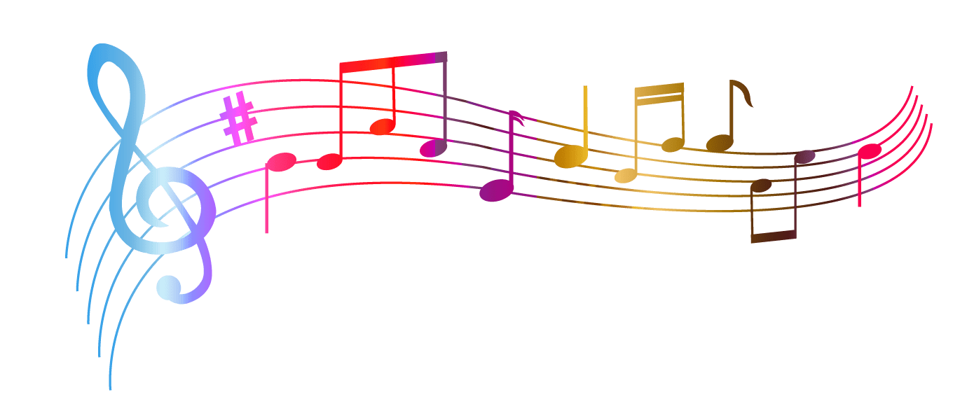
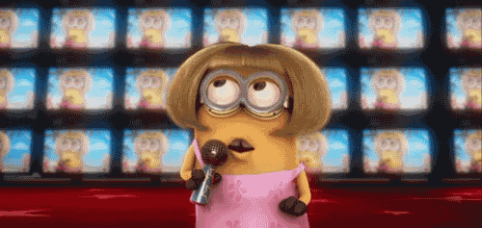
(A) Reference-dependent evaluation
Sound & Music Computing Lab
Current singing evaluation research and apps ^{[1,2]} compare test singer with musical notes
Musical notes of the song
Singing Quality Score
Drawbacks
Musical notes as reference are unable to represent human voice
- pitch transitions, modulations, and voice timbre
Test singer
[1] W. H. Tsai, and H. C. Lee, “Automatic evaluation of karaoke singing based on pitch, volume, and rhythm features,” IEEE Trans. on Audio, Speech, and Language Processing, vol. 20(4), pp. 1233-1243, 2012.
[2] Smule Sing!, Starmaker

Slide 10
Perceptual Evaluation of Singing Quality (PESnQ)
Sound & Music Computing Lab
Signal processing-based objective features for pitch, rhythm etc.
Reference singing
Cognitive Modeling
Regression
PESnQ score
Test singing
Notes:
Use signal processing methods to describe the percpetual parameters like pitch, rhythm etc.

Slide 11
Sound & Music Computing Lab
How do we measure Rhythm Consistency?
REFERENCE
Same words, but speed varies!
TEST
The spectral feature that represents words or the lyrical content -
MFCC
We computed the alignment between the MFCC vectors of reference and test singing signals – DTW

Slide 12
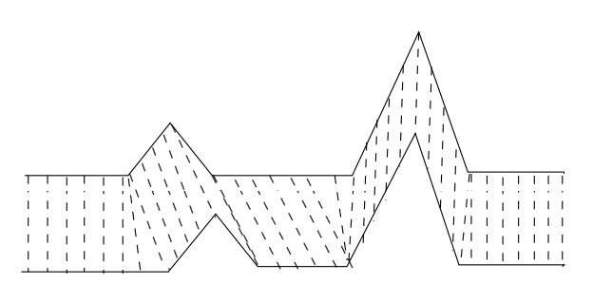
Sound & Music Computing Lab
Rhythm Consistency
Dynamic time warping (DTW) measures the similarity between two temporal sequences, which may vary in speed – or different lengths
REFERENCE
TEST

Slide 13
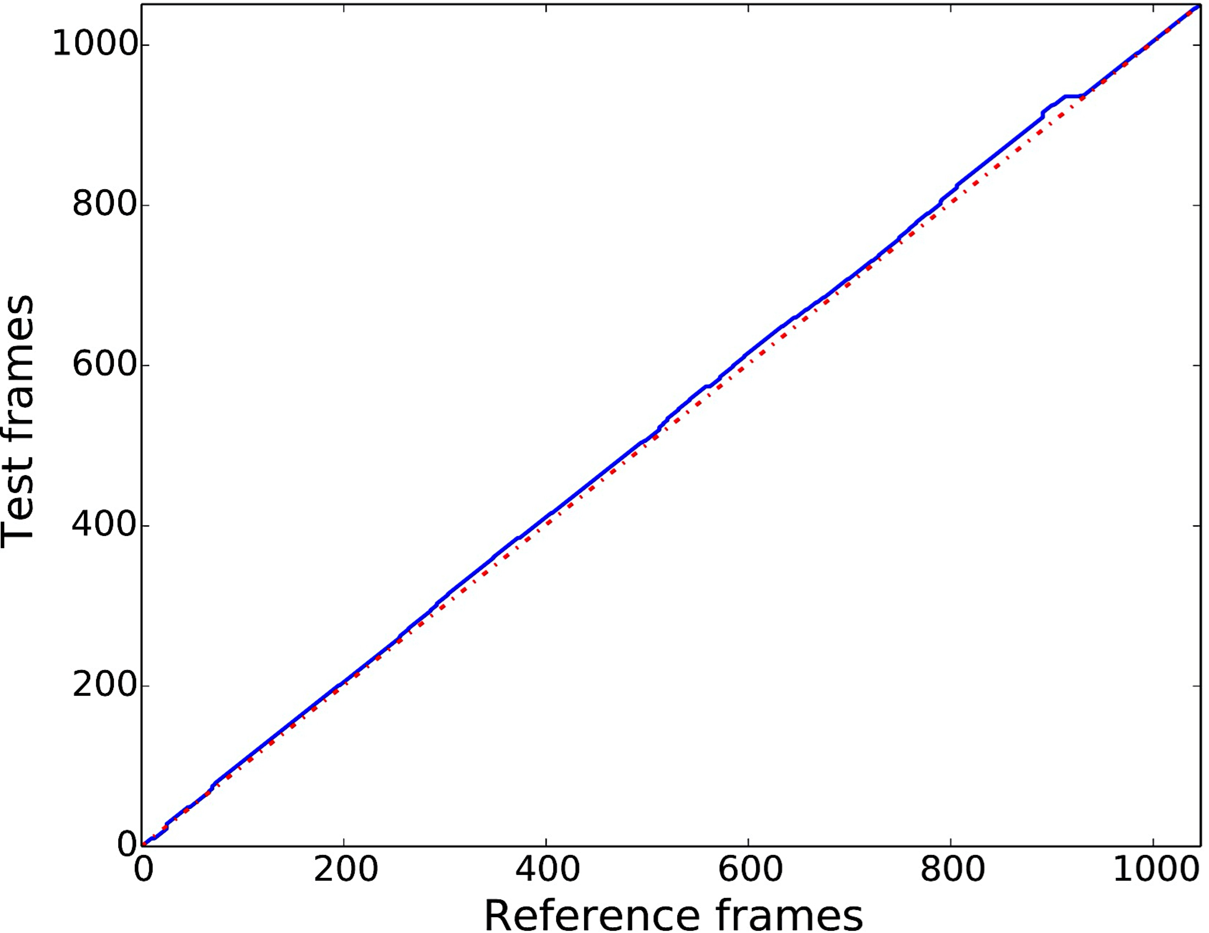
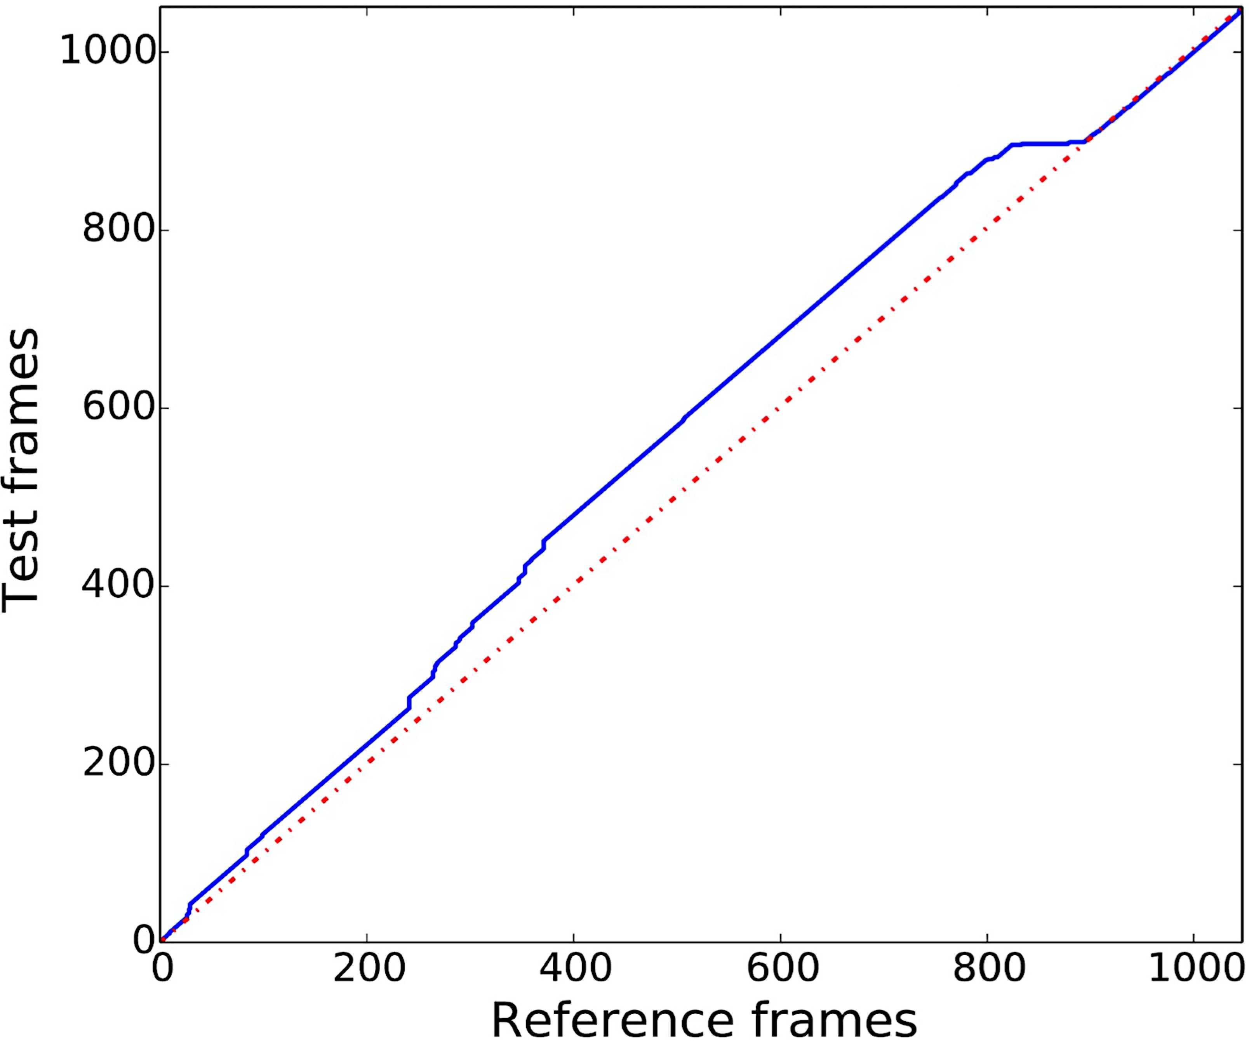
Sound & Music Computing Lab
Rhythm Consistency
Use DTW of MFCC vectors between frame-equalized reference and test Frame-equalized because: Uniformly faster or slower tempo shouldn’t be penalized
Reference Vs. Good Reference Vs. Poor
Notes:
What do MFCC vectors represent in singing signal?

Slide 14
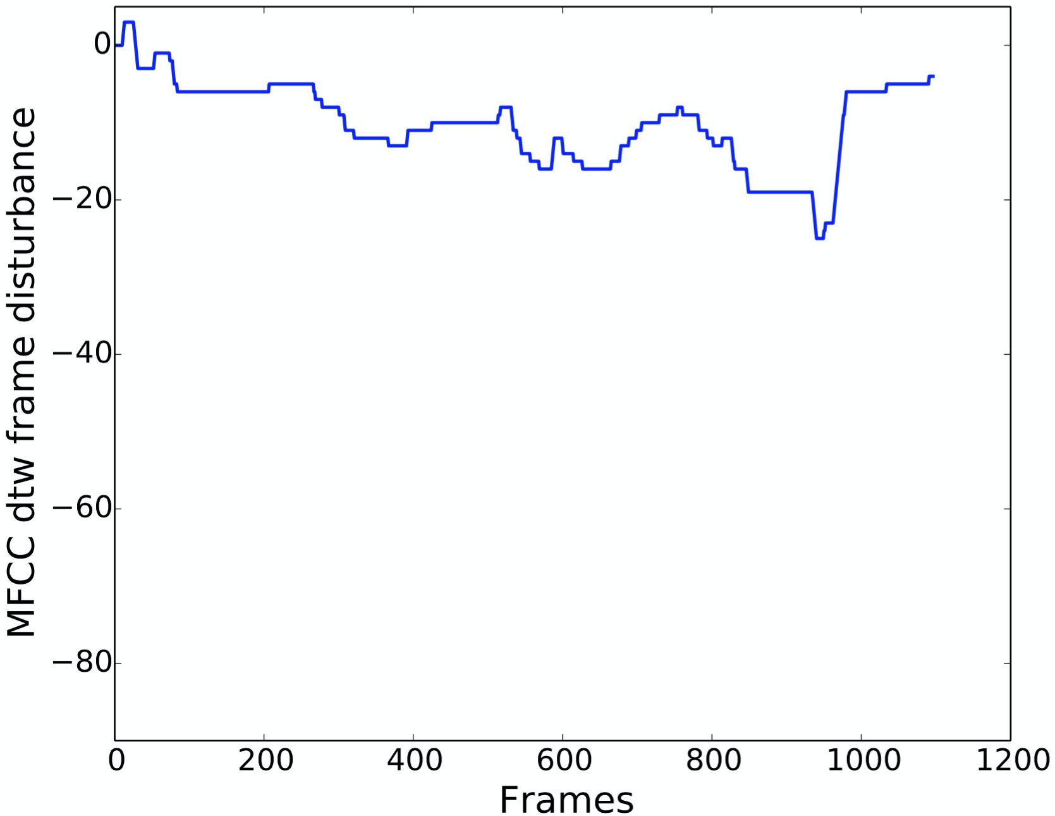
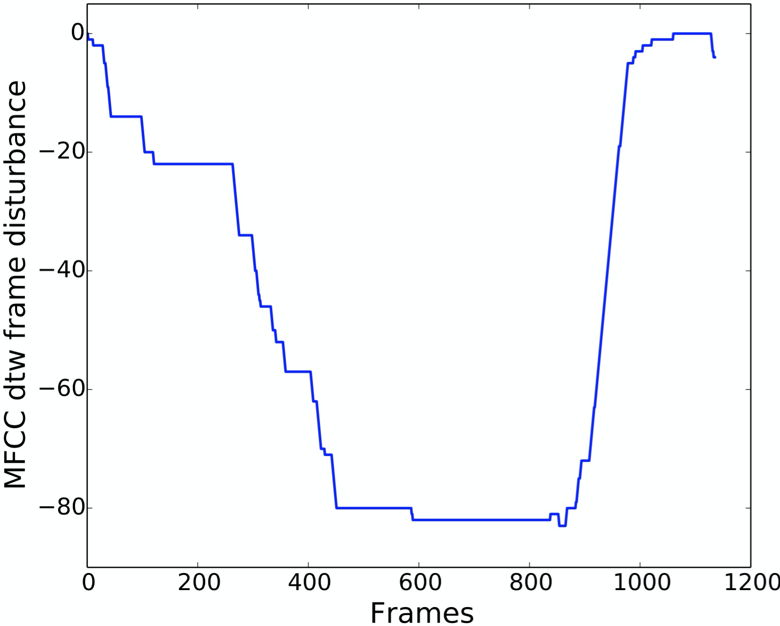
Rhythm Consistency
Sound & Music Computing Lab
Frame disturbances: Deviation of the least cost path from the diagonal for every frame
Reference Vs. Good Reference Vs. Poor
Notes:
For every frame, we therefore get the Frame Disturbance

Slide 15
Cognitive Modeling
Sound & Music Computing Lab
Combine frame-disturbances of these features with cognitive modeling inspired by telecommunication standard PESQ [Hollier1994]:
a localized error in time has a larger subjective
impact than a distributed error
Localized error: L6-norm over split second intervals (320ms)
Distributed error: L2-norm over all split second intervals
[Hollier1994] M. P. Hollier, M. O. Hawksford, and D. R.. Guard, “Error activity and error entropy as a measure of psychoacoustic significance in the perceptual domain,” IEE Proc. Vision, Image and Signal Processing, vol. 141(3), pp. 203-208, 1994.

Slide 16
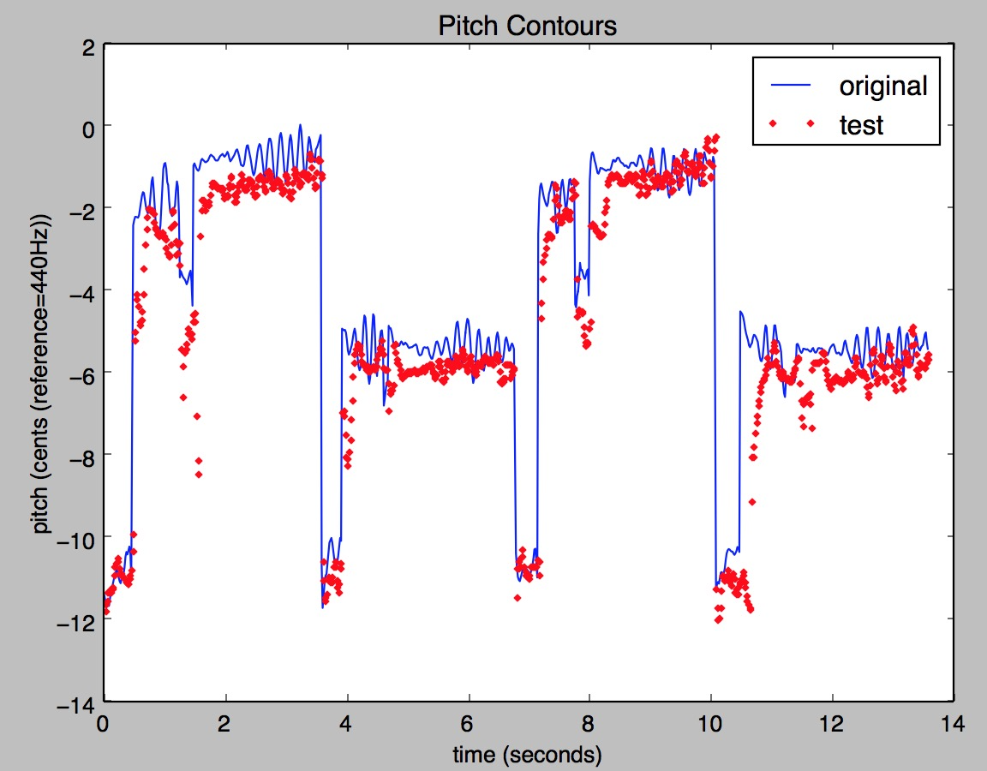
Intonation Accuracy
Sound & Music Computing Lab
Which feature represent intonation or melody?
Compute DTW between the pitch contours from reference and test signals
Key transposition should not be penalized → pitch derivative, and median-subtracted pitch
Notes:
Which feature represents intonation or melody?

Slide 17
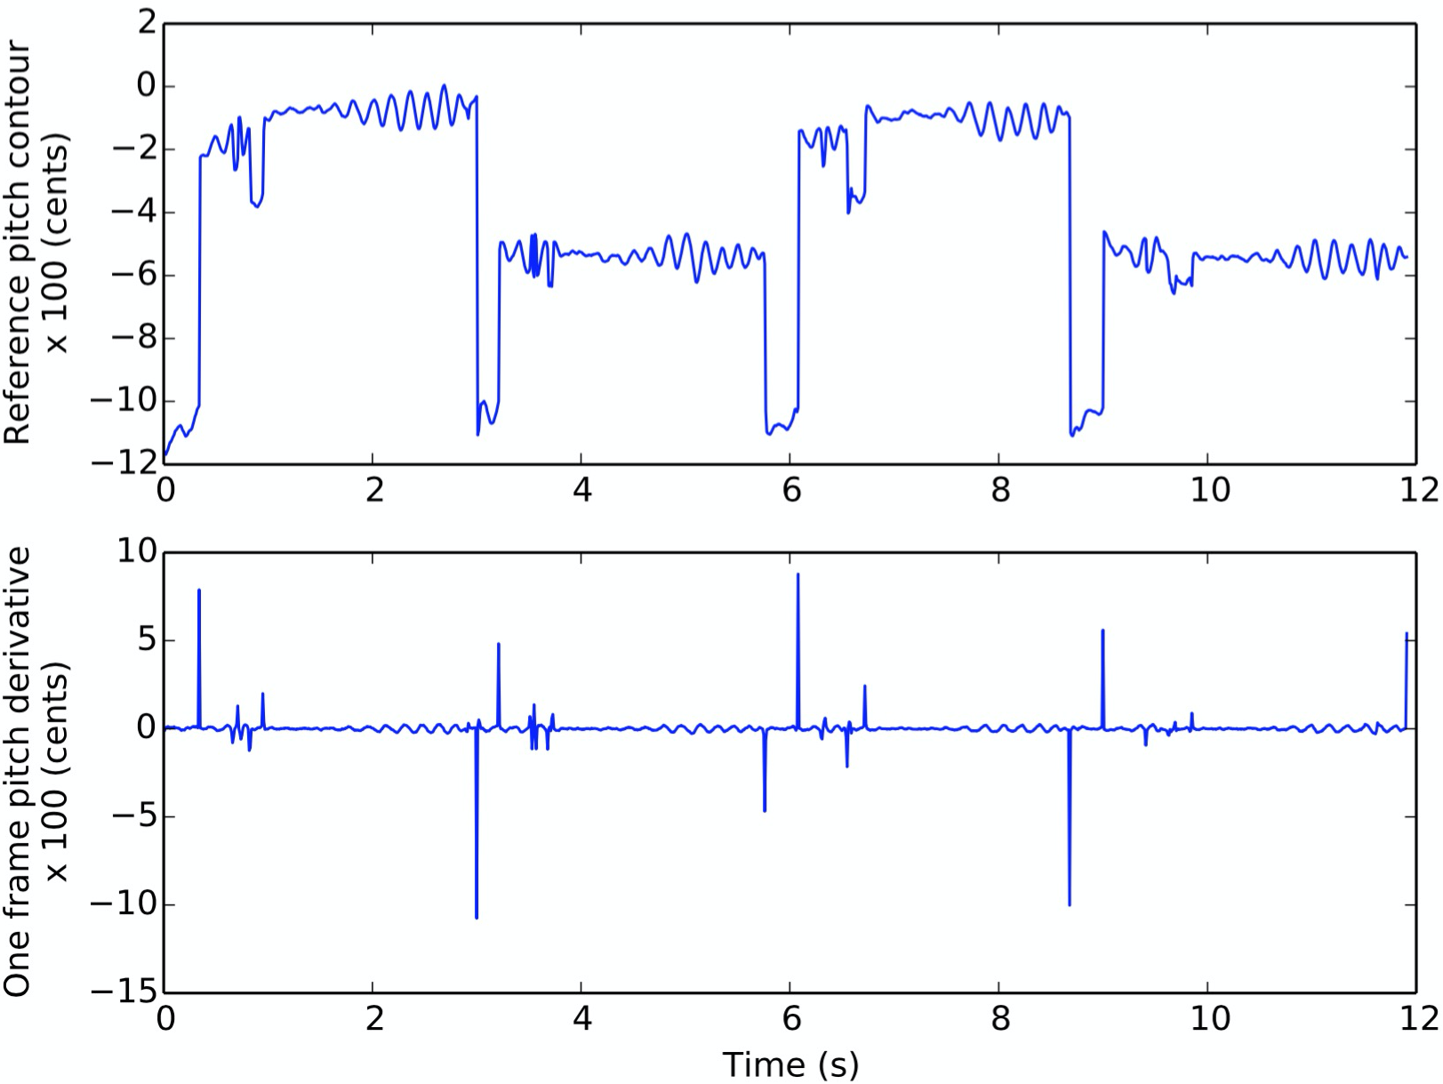
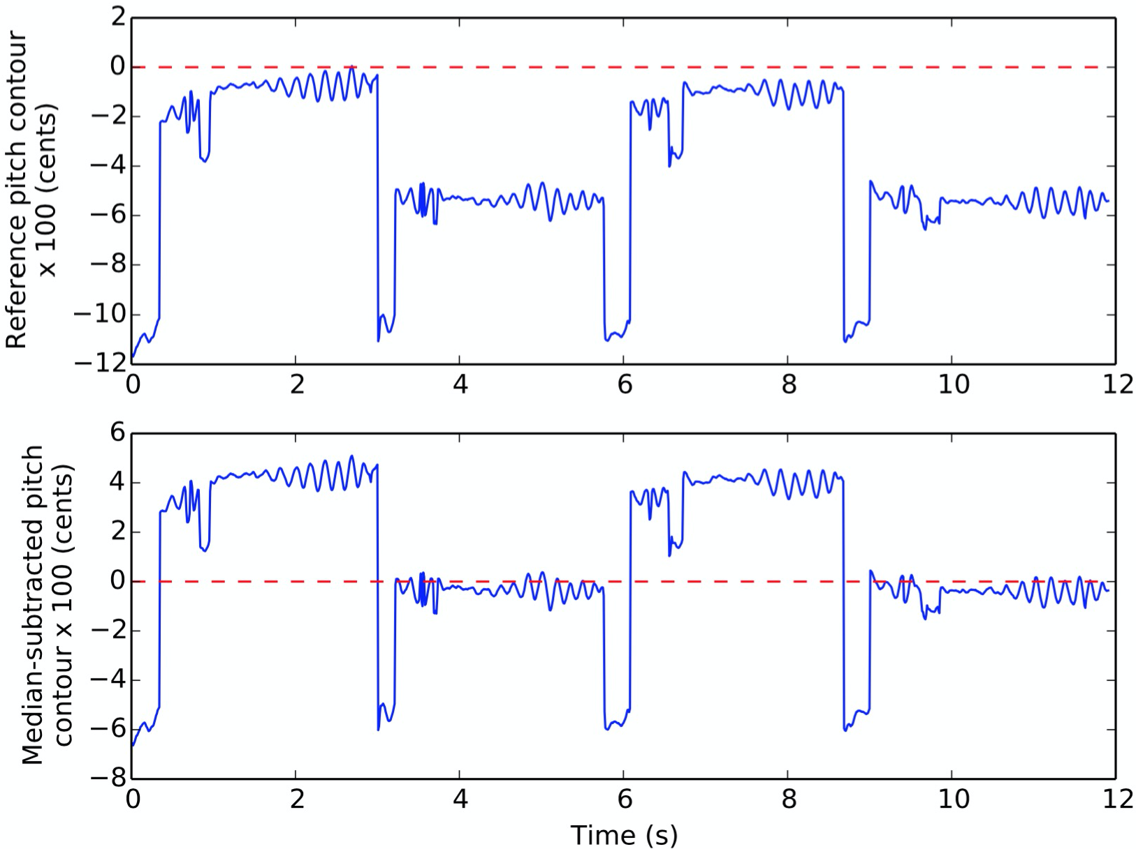
Intonation Accuracy
Sound & Music Computing Lab
Key transposition should be allowed → pitch derivative, and median-subtracted pitch
Pitch derivative Median-subtracted pitch

Slide 18
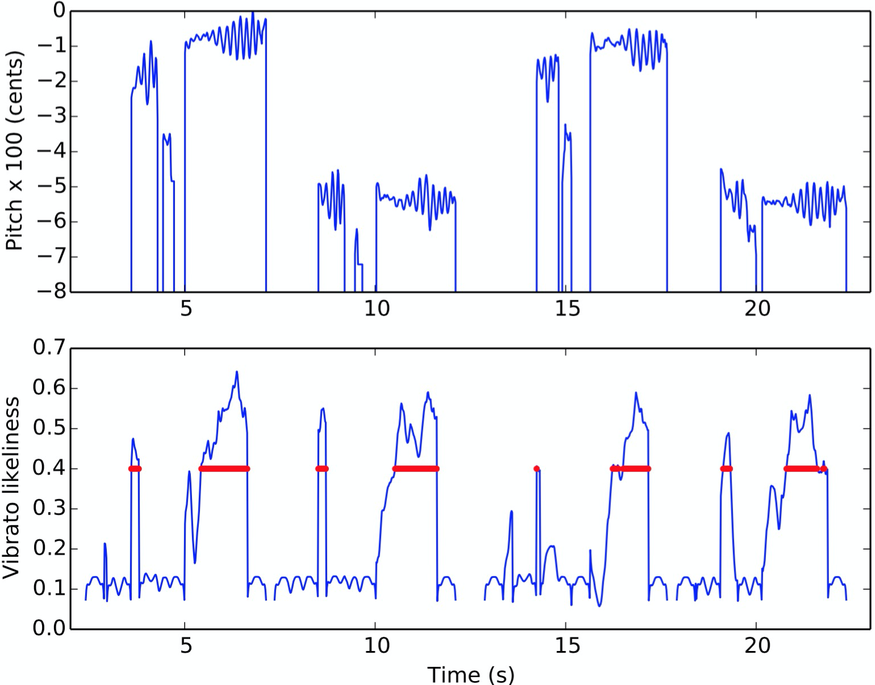
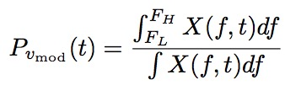
Appropriate Vibrato
Sound & Music Computing Lab
Vibrato oscillations:
Rate: 5-8 Hz Extent: 30-150 cents
Detect vibrato segments in reference based on vibrato likeliness
Valid vibrato segments compared
Features: vibrato likeliness, rate, extent

Slide 19
Other features
Sound & Music Computing Lab
Voice quality: Cumulative DTW distance between MFCC feature vectors
Volume: similarity in the pattern of volume variations across time when different singers perform the same song
Pitch Dynamic Range: Comparison of the difference between min and max pitch values

Slide 20
Comparison of methods
Sound & Music Computing Lab
System | Description
Existing methods | Pitch distance [Tsai2012], pitch-aligned rhythm distance [Molina2013], volume distance [Chang2007, Tsai2012]
PESnQ | Combinations of L2-norm, L6+L2-norm and distance features for the various MFCC-aligned perceptual features
[Chang2007] ]P. C. Chang, “Method and Apparatus for Karaoke Scoring,” U.S. Patent No. 7304229, 2007.
[Tsai2012] W. H. Tsai, and H. C. Lee,“Automatic evaluation of karaoke singing based on pitch, volume, and rhythm features,” IEEE Trans. on Audio, Speech, and Language Processing, vol. 20(4), pp. 1233-1243, 2012.
[Molina2013] E. Molina, I. Barbancho, E. G´omez, A. M. Barbancho, and L. J. Tard´on, “Fundamental frequency alignment vs. note-based melodic similarity for singing voice assessment,” IEEE ICASSP, pp. 744-748, 2013.

Slide 21
Results
Sound & Music Computing Lab
DATASET: 20 solo-singing recordings collected from 20 singers with varied singing abilities – professional to poor ([Duan2013]+new recordings)
GROUND-TRUTH: 5 professionally trained musicians, overall singing quality rating 1-5
Inter-Judges Pearson’s Correlation: 0.82
System | Pearson’s correlation with music experts | Leave-one-judge-out avg. correlation score
Existing methods | 0.30 | 0.38
PESnQ | 0.59 | 0.66
[Duan2013] Z. Duan, H. Fang, B. Li, K. C. Sim, and Y. Wang, “The NUS sung and spoken lyrics corpus: A quantitative comparison of singing and speech,” IEEE APSIPA, pp. 1-9, 2013.
Notes:
Linear regression or Multi-layer perceptron
maximum correlation achieved
amongst human judges, thus it is also the upper bound of
the achievable performance of machine-based singing quality
evaluation.

Slide 22
Sound & Music Computing Lab
Contributions
Adopting the cognitive modeling theory of PESQ to design a PESnQ score showing improvement over existing methods in correlating with the music-experts
MFCC-aligned features perform better than the existing pitch-aligned features for singing evaluation
Publications
1. Chitralekha Gupta, Haizhou Li, and Ye Wang, “Perceptual Evaluation of Singing
Quality”, In Proceedings of Asia-Pacific Signal and Information Processing Association
(APSIPA), Kuala Lumpur, 2017 (BEST PAPER AWARD)
2. Chitralekha Gupta, Haizhou Li, and Ye Wang, “A Technical Framework for Automatic
Perceptual Evaluation of Singing Quality”, Transactions of APSIPA, 2018.

Slide 23
Drawbacks of existing singing evaluation methods
Sound & Music Computing Lab
http://www.smcnus.org/
Constrained by the need of a reference for every song
Cover songs may not be exactly like the original song, meaning that the closeness to the reference may not be the complete story
Results in challenges to discover talented singers from the ever-increasing uploads on online singing talent platforms (eg. Smule Sing!, K Ge, SoundCloud, Youtube)
Music experts can evaluate singing quality with high consensus when the melody or the song is unknown^{[1]}
➔ there are inherent properties of singing quality that are independent of a reference singer or melody
[1] T. Nakano, M. Goto, and Y. Hiraga, “Subjective evaluation of common singing skills using the rank ordering method,” 9th International Conference on Music Perception and Cognition, 2006
Notes:
Because the algorithm gets constrained by the need for a reference for every new song professional grade reference singer of the song, or availability of the musical notes of the song
➔ There are inherent properties of singing quality that are independent of a reference singer or melody, which help the music-experts to judge singing quality without a reference

Slide 24
Thesis overview
Sound & Music Computing Lab
GOAL: Design and investigate objective techniques to model singing voice, and characterize and assess singing quality
Singing Quality Evaluation
Prosody
Pronunciation
☑
Reference-dependent
Reference-independent
Phonetic modeling of singing voice
Application 1: Pronunciation Evaluation
Application 2: Lyrics-to-audio alignment

Slide 25
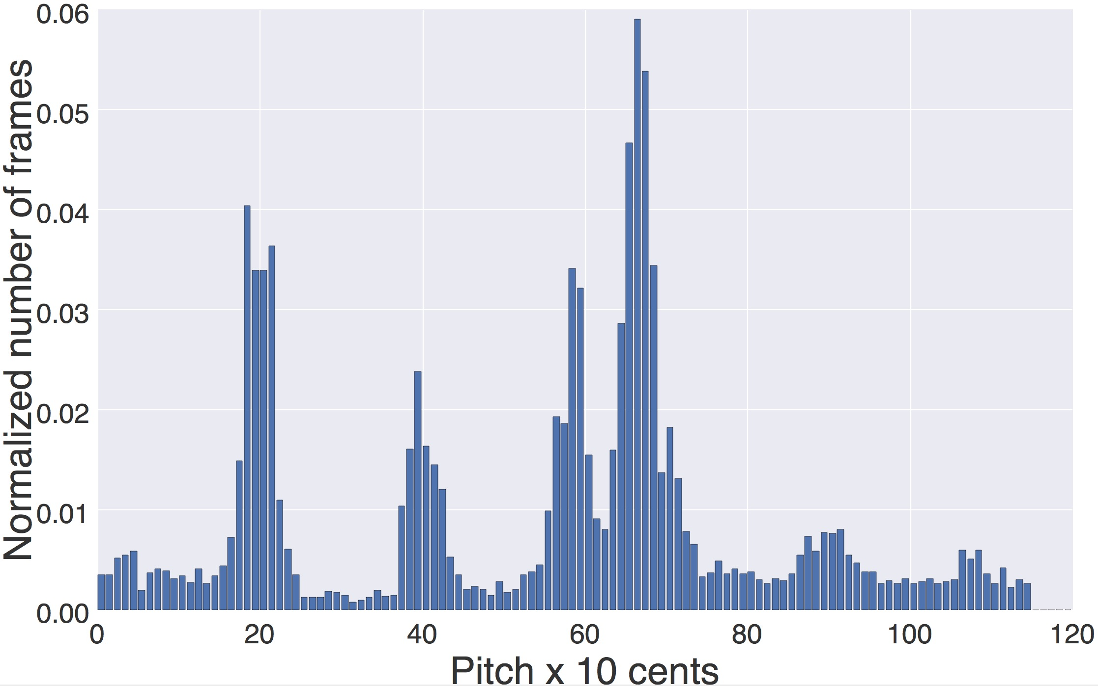
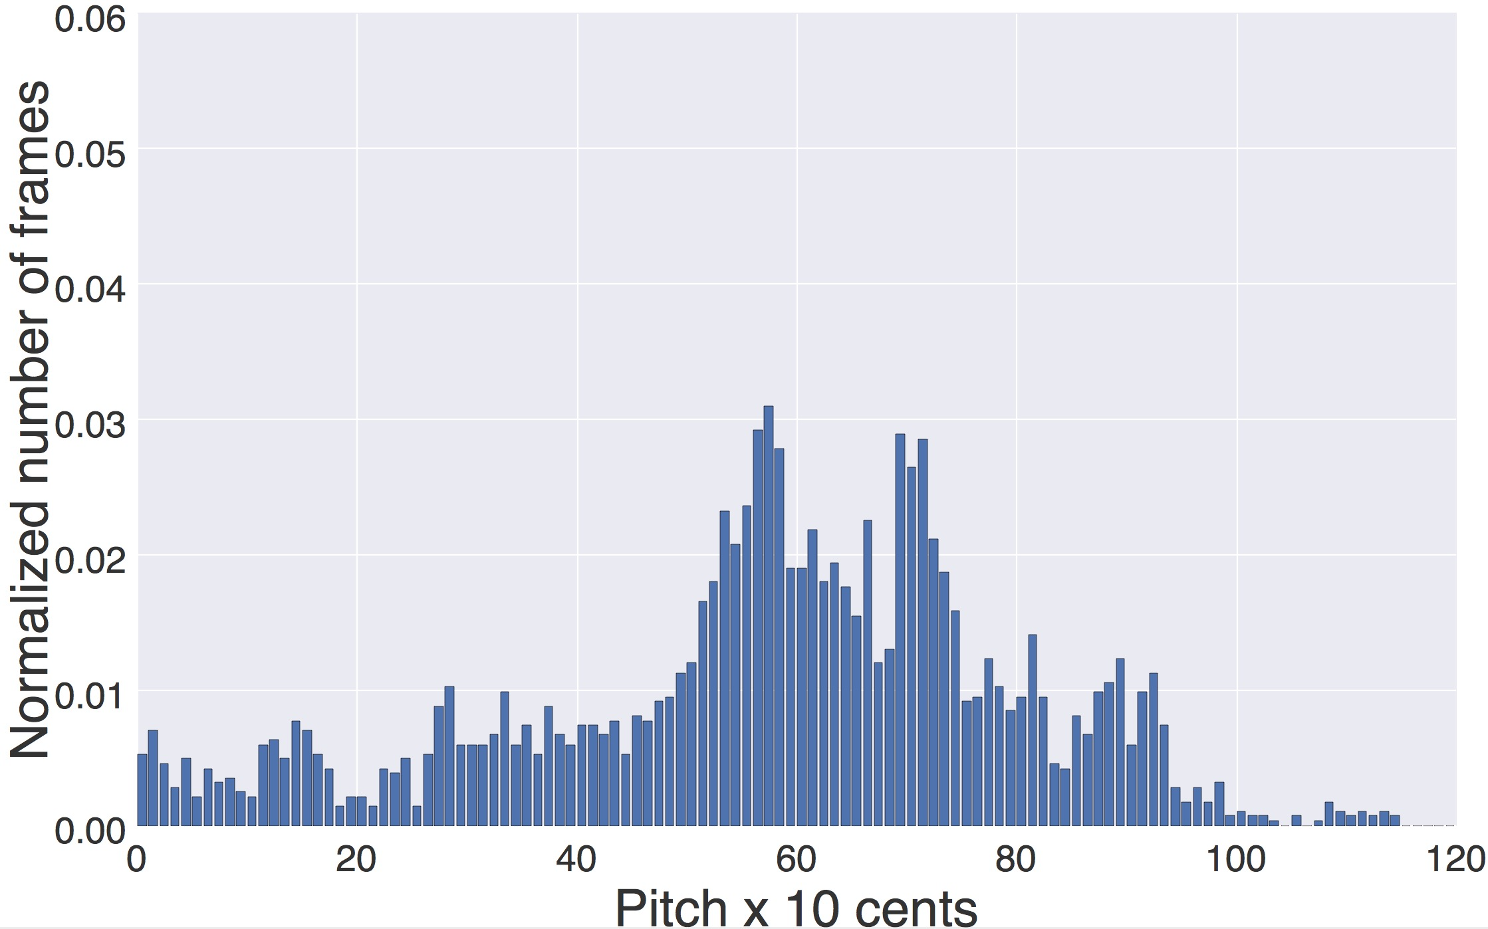
(B) Reference-independent singing quality evaluation
Sound & Music Computing Lab
http://www.smcnus.org/
Characterization of pitch histogram: distribution of pitch values in a sung rendition. A pitch histogram is computed as the count of the pitch values folded on to the 12 semitones in an octave.
Good Singer
Bad Singer
Notes:
Since generally a song consists of only a set of dominant notes, the “spikiness” of the pitch histogram of the good singer indicates that the notes of
the song (wrapped onto an octave) are being hit repeatedly and consistently. On the other hand, the poor singer has a dispersed distribution of pitch values indicating that the singer is unable to hit the dominant notes of the song consistently.

Slide 26
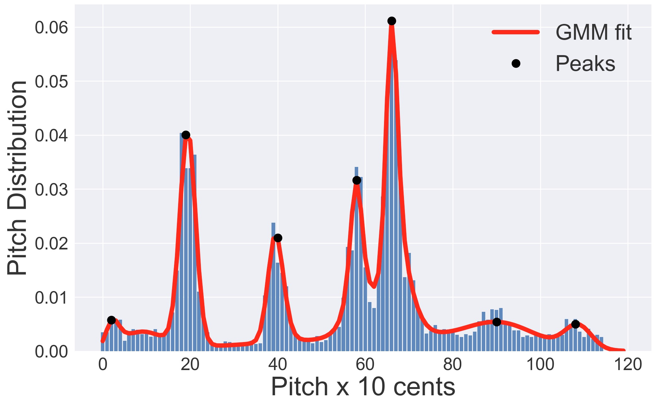
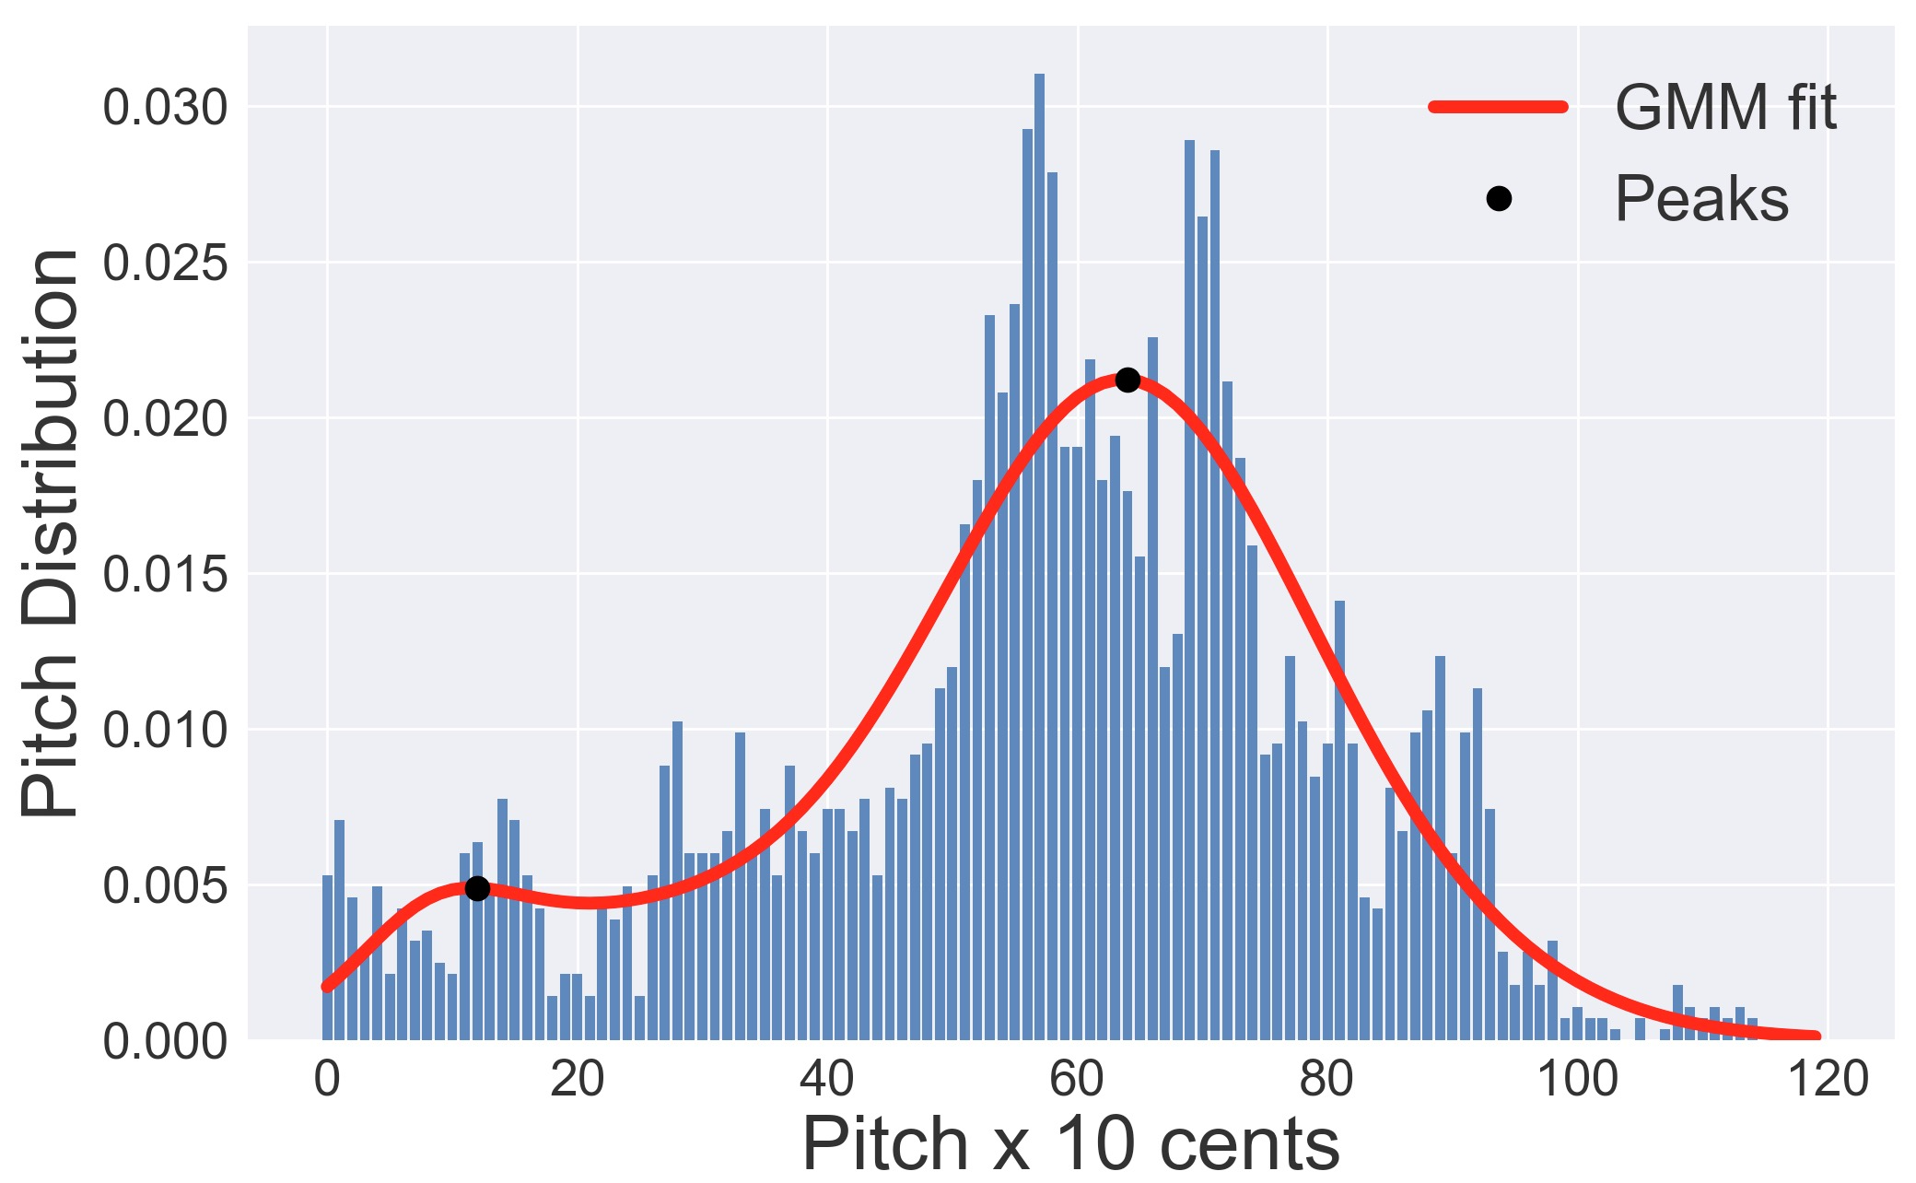
Musically-motivated absolute measures
Sound & Music Computing Lab
http://www.smcnus.org/
Good Singer
Bad Singer
From the perspective of overall pitch distribution^{[1,2]}: Kurtosis, Skew (BASELINE FEATURES)
From the perspective of pitch concentration: GMM-fit, Autocorrelation
Clustering-based natural references: kMeans, Binning
[1] J. B ̈ohm, F. Eyben, M. Schmitt, H. Kosch, and B. Schuller, “Seeking thesuperstar: Automatic assessment of perceived singing quality,” in Neural Networks (IJCNN), 2017 International Joint Conference on.IEEE,2017, pp. 1560–1569
[2] Nichols, C. DuHadway, H. Aradhye, and R. F. Lyon, “Automatically discovering talented musicians with acoustic analysis of youtube videos,”inData Mining (ICDM), 2012 IEEE 12th International Conference on.IEEE, 2012, pp. 559–565.
Notes:
A pitch histogram is computed as the count of the pitch values of a singing rendition folded on to the 12 semitones in an octave
12 semitones x 10 bins each = 120 bins in total, each representing 10 cents
Since generally a song consists of only a set of dominant notes, the “spikiness” of the pitch histogram of the good singer indicates that the notes of
the song (wrapped onto an octave) are being hit repeatedly and consistently. On the other hand, the poor singer has a dispersed distribution of pitch values indicating that the singer is unable to hit the dominant notes of the song consistently.

Slide 27
Experiment Results
Sound & Music Computing Lab
http://www.smcnus.org/
Data: 5 English popular songs, each sung by 10 singers
Ground-Truth: Crowd-sourcing Mturk: Best-Worst Scaling (BWS) Ranks;
We asked listeners to choose the best and the worst tracks among 3 singers based on singing quality
Applied filters to the MTurk users by testing their musical background, and seriousness while performing the task
Mturk Reliability Test: Lab-controlled music experts Vs Mturk users Pearson’s Corr = 0.931
Avg. over all songs | Baseline features | Proposed features | Combination
 | 0.433 | 0.599 | 0.610
DRAWBACKS
Other perceptual parameters are ignored – rhythm, timbre, vibrato etc
The relative positions of the peaks in the histogram are not captured

Slide 28

Analogy with “Truth-Discovery”^{[1]}
Sound & Music Computing Lab
http://www.smcnus.org/
Inter-singer statistics-based relative measures
Discovering good singers from a large pool of singers
≈
finding “true” facts from a large amount of conflicting information provided by various websites
Analogy from Truth-Discovery Literature^{[1]} | Our Hypothesis
Usually only one true fact for a property of an object | Usually only one correct way to sing a song
This true fact appears to be the same or similar on different websites, eg. “Jennifer Widom’” versus “J. Widom” | This song can be sung correctly in only one or a few similar ways by different singers
Different websites often make different mistakes for the same fact, providing different false “facts” | Poor singers will sing the song in many different and dissimilar ways
^{[1]} Yin, Xiaoxin, Jiawei Han, and S. Yu Philip. "Truth discovery with multiple conflicting information providers on the web." IEEE Transactions on Knowledge and Data Engineering 20.6 (2008): 796-808.

Slide 29
Inter-singer statistics-based relative measures
Sound & Music Computing Lab
http://www.smcnus.org/
A novel comparative approach that captures the inter-singer statistics in a large pool of singers and leads us to a self-organizing way of rank-ordering singers
Our hypothesis:
a song can be sung correctly in only one or a few similar ways, but incorrectly in many different and dissimilar ways
Therefore the singers who are similar to each other are “good”, while the dissimilar ones are the “poor” singers

Slide 30
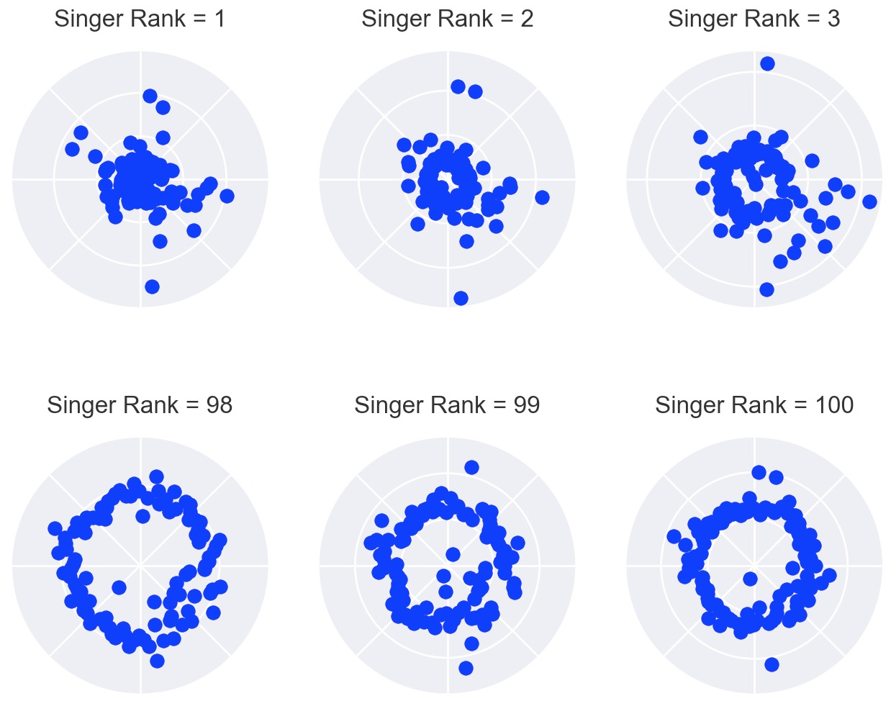
Inter-singer statistics based relative measures
Sound & Music Computing Lab
http://www.smcnus.org/
••Distance between median-subtracted pitch contour between two singers

Slide 31
Inter-singer statistics based relative measures
Sound & Music Computing Lab
http://www.smcnus.org/
Singer Rank = 70
Pitch patterns are similar
However, such similarity in bad singing is rare
••Distance between median-subtracted pitch contour between two singers

Slide 32
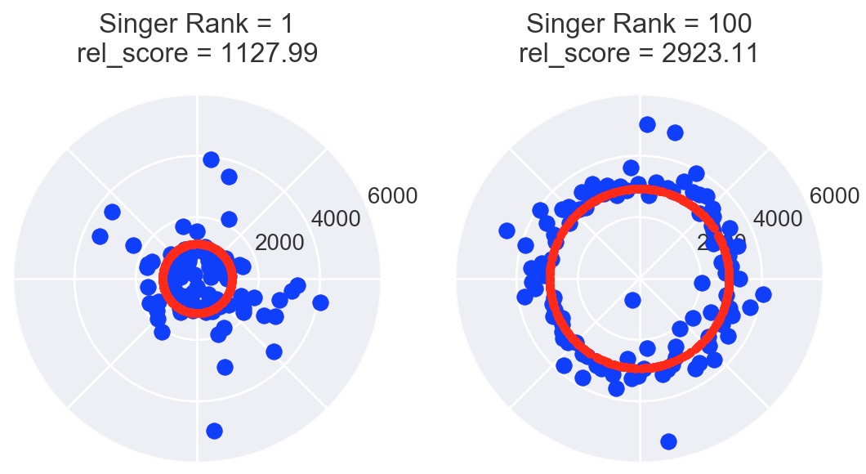
Relative scoring method
Sound & Music Computing Lab
http://www.smcnus.org/
Relative score of singer x is measured as the distance of the 10th nearest singer to x, in terms of an objective parameter, eg. median-subtracted pitch contour
The number of singers threshold is empirically set as 10 singers ➔ assuming that roughly at least 10% of singers in a large pool of singers would be good

Slide 33
Summary of reference-independent measures
Sound & Music Computing Lab
http://www.smcnus.org/
Based on | Metric names |  | Description
ABSOLUTE MEASURES
Pitch | Kurtosis, Skew |  | From the perspective of overall pitch distribution
 | PeakBW, PeakConc_110, PeakConc_50, Autocorr |  | From the perspective of pitch concentration
 | kMeans, Binning |  | Clustering-based natural reference
RELATIVE MEASURES
Pitch | pitch_med_dist, pitch_med_L2, pitch_med_L6_L2 | DTW distance, L2-norm, and L6+L2 norm between median subtracted pitch contours (PESnQ)^{[1]}
 | pitchhist_12KLdist, pitchhist_120KLdist, pitchhist_12Ddist, pitchhist_120Ddist | KL divergence and DTW distance between 12-bin and 120-bin pitch histograms
Rhythm | molina_rhythm_mfcc_dist, rhythm_L2, rhythm_L6_L2 | modified Molina’s distance, L2-norm, and L6+L2 norm between MFCC vectors (PESnQ) ^{[1]}
Timbre | timbral_distance | DTW distance between MFCC vectors (PESnQ) ^{[1]}

Slide 34
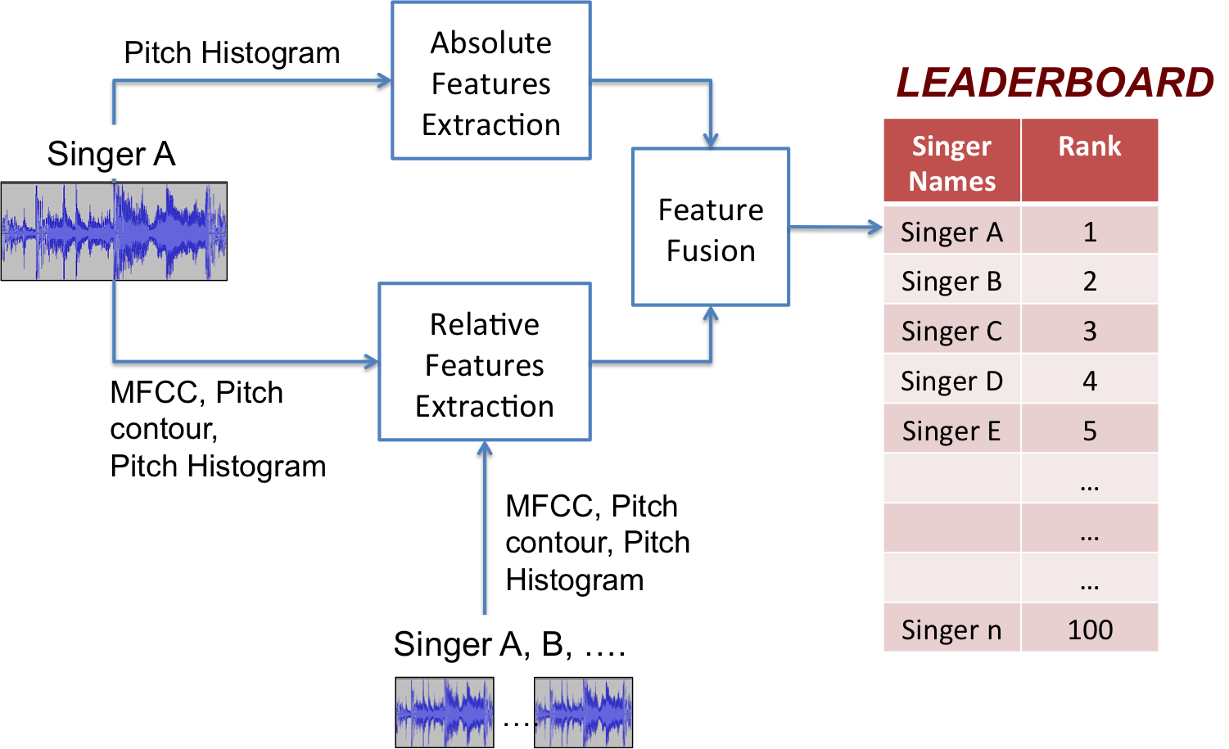
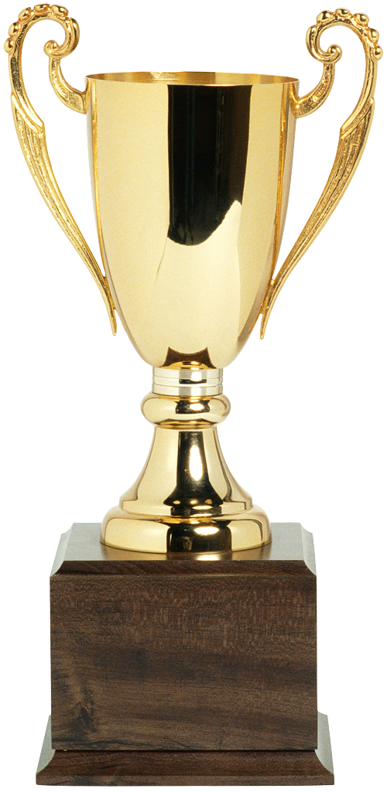
Framework overview
Sound & Music Computing Lab
http://www.smcnus.org/

Slide 35
Sound & Music Computing Lab
http://www.smcnus.org/
Experimental Data
4 popular English songs from Smule’s Sing! Karaoke dataset, each sung by 100 unique singers (50M,50F)
Subjective ground-truth in terms of best-worst scaling ranks obtained from crowd-sourcing platform Mturk

Slide 36
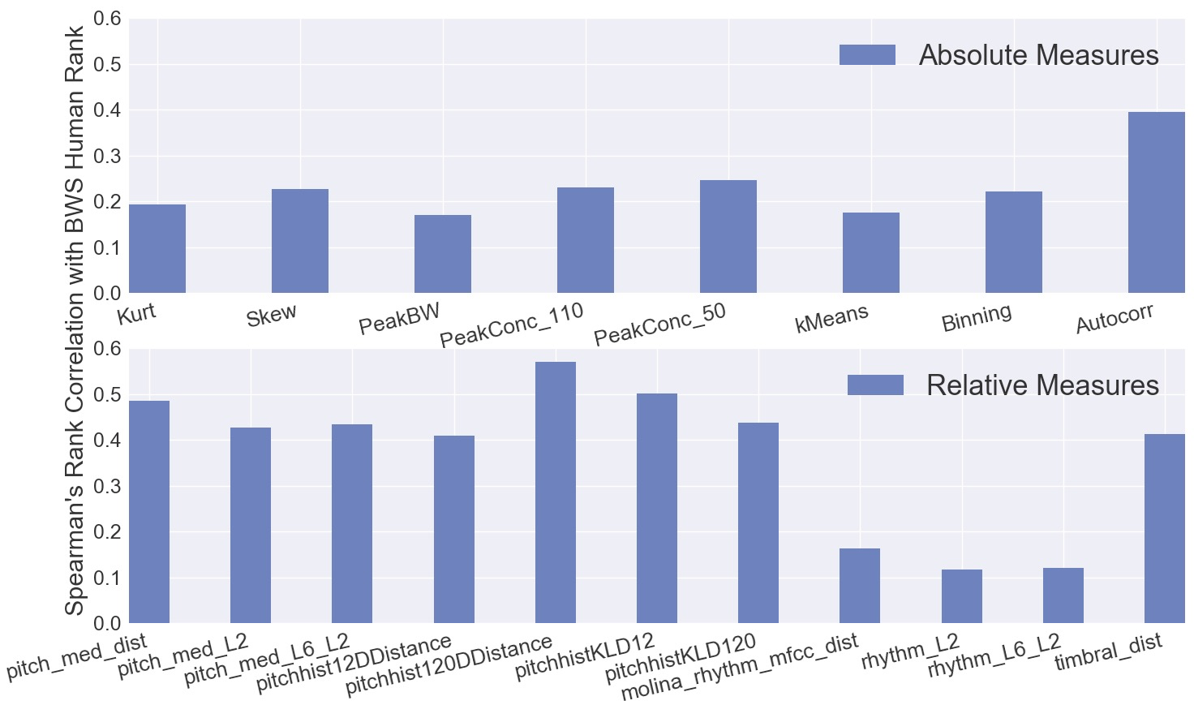
Individual Measures Analysis
Sound & Music Computing Lab
http://www.smcnus.org/
The relative measures perform better than the absolute measures
The pitch-based relative measures perform better than the rhythm-based relative measures
Spearman's rank correlation of the individual absolute measures (top) and relative measures (bottom) with human BWS ranks.

Slide 37
Overall machine rank vs. human rank
Sound & Music Computing Lab
http://www.smcnus.org/
Baseline^{[1]}: Interspeech ComParE 2013 (Computational Paralinguistics Challenge) feature set. The Spearman's rank correlation between the human BWS rank and the output of this model is 0.39
Model | Absolute measures | Relative measures | Fusion
Rank avg. | 0.479 | 0.639 | 0.706
Linear Reg. | 0.421 | 0.574 | 0.643
MLP-sigmoid, no hidden layer | 0.398 | 0.579 | 0.641
MLP-ReLU, no hidden layer | 0.384 | 0.569 | 0.627
MLP-sigmoid, 1 hidden layer, 5 nodes | 0.471 | 0.615 | 0.669
MLP-ReLU, 1 hidden layer, 5 nodes | 0.460 | 0.602 | 0.668
^{[1]}Böhm, Johanna, et al. "Seeking the SuperStar: Automatic assessment of perceived singing quality." Neural Networks (IJCNN), 2017 International Joint Conference on. IEEE, 2017.

Slide 38
Overall machine rank vs. human rank
Sound & Music Computing Lab
http://www.smcnus.org/
Existing measures^{[1]}: Interspeech ComParE 2013 (Computational Paralinguistics Challenge) feature set. The Spearman's rank correlation between the human BWS rank and the output of this model is 0.39
Spearman’s Rank Correlation between human ranks and machine ranks
Absolute Features | Relative Features | Feature Fusion | Inter-Human
0.48 | 0.64 | 0.71 | 0.82

Slide 39
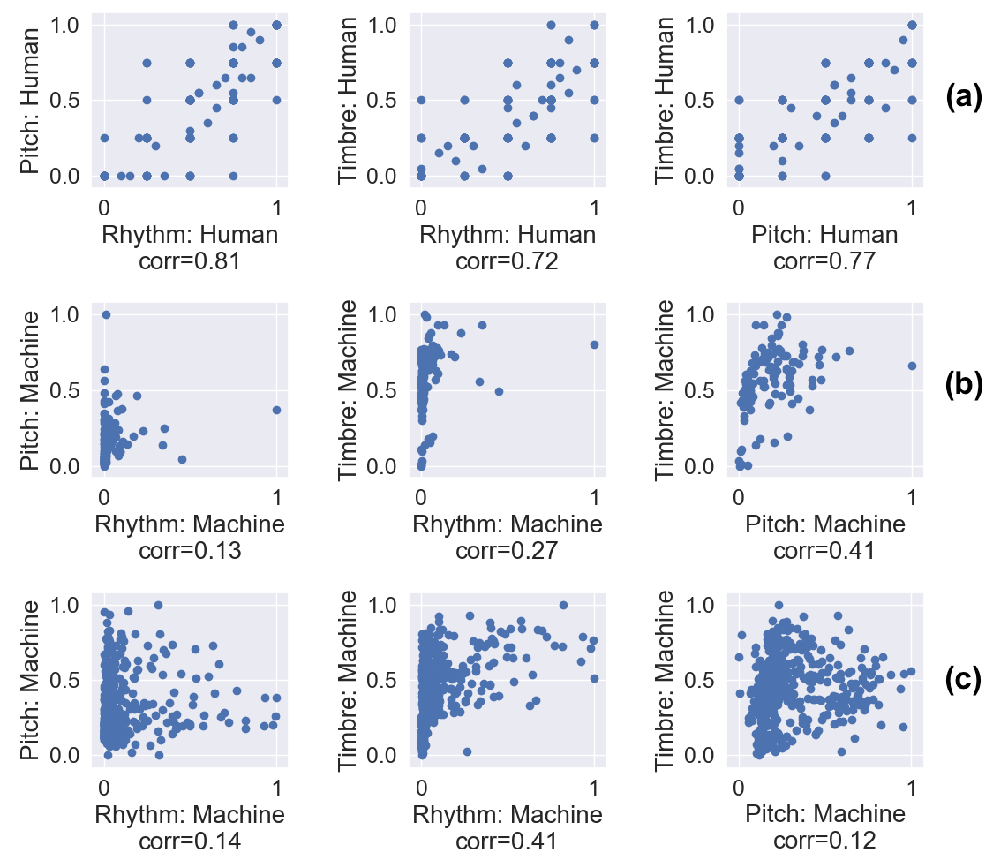
Humans vs. machines – individual parameters
Sound & Music Computing Lab
http://www.smcnus.org/
human experts for previously used data ^{[1]}
machine, on the same data as in (a),
machine scores for the current data
^{[1]} Chitralekha Gupta, Haizhou Li, and Ye Wang. “Perceptual Evaluation of Singing Quality”, Asia-Pacific Signal and Information Processing Association (APSIPA), Kuala Lumpur, Dec. 2017

Slide 40
Contributions
Sound & Music Computing Lab
http://www.smcnus.org/
A self-organizing truth-finding based method to rank-order large number of singing renditions based on singing quality without relying on a reference singer
inter-singer relative distance measures and musically motivated pitch histogram-based measures to characterize the inherent properties of singing quality
We provide evidence that indicates that machines can provide a more unbiased assessment of the underlying parameters of singing quality compared to humans
Publications
Chitralekha Gupta, Haizhou Li, and Ye Wang, “Automatic Evaluation of Singing Quality without a Reference”, In Proceedings of Asia-Pacific Signal and Information Processing Association (APSIPA), Hawaii, 2018
Chitralekha Gupta, Haizhou Li, and Ye Wang, “Automatic Leaderboard: Evaluation of singing quality without a standard reference”, submitted to IEEE Transactions on Audio, Speech, and Language Processing, 2019 (Under review).

Slide 41
PRONUNCIATION-BASED EVALUATION
Sound & Music Computing Lab

Slide 42
Motivation
Sound & Music Computing Lab
http://www.smcnus.org/
Pronunciation of lyrics is an important component of singing performance
Singing is shown to improve pronunciation in foreign language learning
Music and speech therapists apply Melodic Intonation Therapy to treat patients with speech disorders, such as non-fluent aphasia

Slide 43
Thesis overview
Sound & Music Computing Lab
GOAL: Design and investigate objective techniques to model singing voice, and characterize and assess singing quality
Singing Quality Evaluation
Prosody
Pronunciation
☑
Reference-dependent
Reference-independent
Phonetic modeling of singing voice
Application 1: Pronunciation Evaluation
Application 2: Lyrics-to-audio alignment
☑

Slide 44
Challenges?
Sound & Music Computing Lab
http://www.smcnus.org/
a lack of transcribed singing dataset to train phonetic models for singing voice
differences between sung and spoken voices, cannot use speech recognizer directly

Slide 45
Openly available singing voice dataset
Sound & Music Computing Lab
http://www.smcnus.org/
Smule Sing! Karaoke
35k+ recordings of solo singing (monophonic), 301 unique songs (from Sept 2017)
Challenges:
time-aligned lyrics not available
inconsistencies in recording conditions
out-of-vocabulary words
incorrectly pronounced words because of unfamiliar lyrics or non-native language speakers

Slide 46
Goals
Sound & Music Computing Lab
http://www.smcnus.org/
Clean-up the dataset; and automatically obtain sentence-level alignment of lyrics to solo-singing vocals
Train acoustic models for sung phonemes
Account for differences between singing and speech – duration
Evaluate lyrics recognition, word alignment, and pronunciation
Notes:
ASR as well as an external resource, i.e. published lyrics.

Slide 47
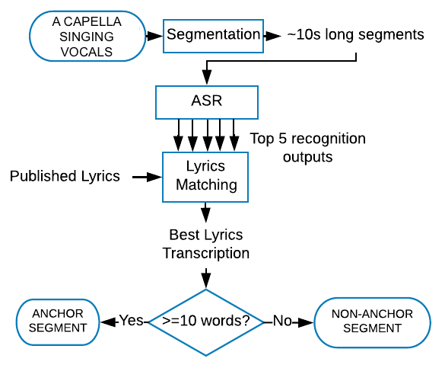
Data clean-up and auto-lyrics alignment strategy
Sound & Music Computing Lab
http://www.smcnus.org/

Slide 48
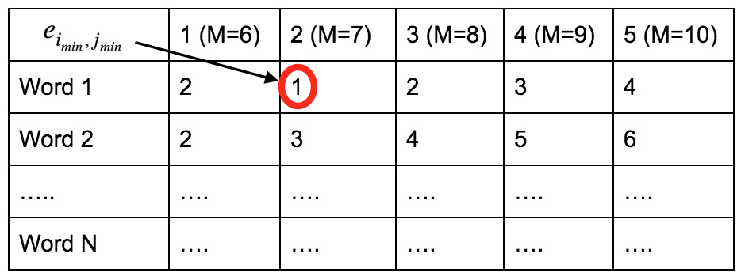
Lyrics-Matching
Sound & Music Computing Lab
http://www.smcnus.org/
ASR transcript (ASR): “the snow glows on the mountain”
Published lyrics sub-sequence (Pub):
“the snow glows white on the mountain tonight not a footprint….”
M=6; Start Word #1
ASR: the snow glows on the mountain
Pub: the snow glows white on the Error = 2
M=7; Start Word #1
ASR: the snow glows on the mountain
Pub: the snow glows white on the mountain Error = 1
Levenshtein distance

Slide 49
Human Verification of the Quality of the Aligned-Transcriptions
Sound & Music Computing Lab
http://www.smcnus.org/
We asked humans to validate 5,400 (15 hours) anchor segment transcriptions through a listening test
Segment Transcriptions | % | Total %
Correct transcriptions: fully matching ASR | 15.52 | 73.32
Correct transcriptions: partially matching ASR | 57.80
Error transcriptions due to imperfect ASR or incorrect singing | 26.68 | 26.68

Slide 50
Duration Modeling with Lexicon Modification^{[1]}
Sound & Music Computing Lab
http://www.smcnus.org/
Longer duration of vowels can be viewed as a type of pronunciation variation
We modify the lexicon to model longer duration
Eg.: the word “sleep” will have the lexicon variants:
[S L IY P],
[S L IY IY P],
[S L IY IY IY P],
[S L IY IY IY IY P]
The ASR selects the closest matching variant at the time of forced-alignment
[1] Chitralekha Gupta, Haizhou Li, and Ye Wang, “Automatic Pronunciation Evaluation of Singing”, In Proceedings of Interspeech 2018
Notes:
In the speech community, dictionary or lexicon enhancement with pronunciation variants is a popular method to detect pronunciation errors

Slide 51
Sing-adapted ASR
Sound & Music Computing Lab
http://www.smcnus.org/
Speech ASR: trained on librispeech
TRAINING DATA: 50 hrs annotated singing voice data; TEST DATA: 4.7 hrs
Speech-to-singing adaptation: fMLLR, Speaker adaptive training (SAT), duration-based lexicon modeling
Application: Lyrics Recognition
Models Adapted by Singing Data | %Word Error Rate
(1) Baseline (speech acoustic models) | 72.08
(2) Adapted (SAT+DNN) with training data | 37.15
(3) Duration modeling with lexicon^{[4]} | 29.65
Notes:
Feature space maximum linear likelihood regression, we estimate a transformation of the feature vector such that its probability of getting generated from the given model is maximized
estimate fMLLR matrices for the individual training speakers and train on the adapted features; this is called Speaker Adapted Training (SAT)

Slide 52
Thesis overview
Sound & Music Computing Lab
GOAL: Design and investigate objective techniques to model singing voice, and characterize and assess singing quality
Singing Quality Evaluation
Prosody
Pronunciation
☑
☑
Phonetic modeling of singing voice
Application 1: Pronunciation Evaluation
Application 2: Lyrics-to-audio alignment
Reference-dependent
Reference-independent
☑

Slide 53
(B) Application: Pronunciation Evaluation
Sound & Music Computing Lab
http://www.smcnus.org/
Singing-adapted ASR
Duration Modeling with Lexicon Modification (LEX)
Singing
vocal
Word Boundaries
& PPG
(Phonetic Posteriograms)
Scoring
Word Alignment
Pronunciation Score
Lyrics
Notes:
One main difference between singing and speech is the longer duration of the vowels in singing voice

Slide 54
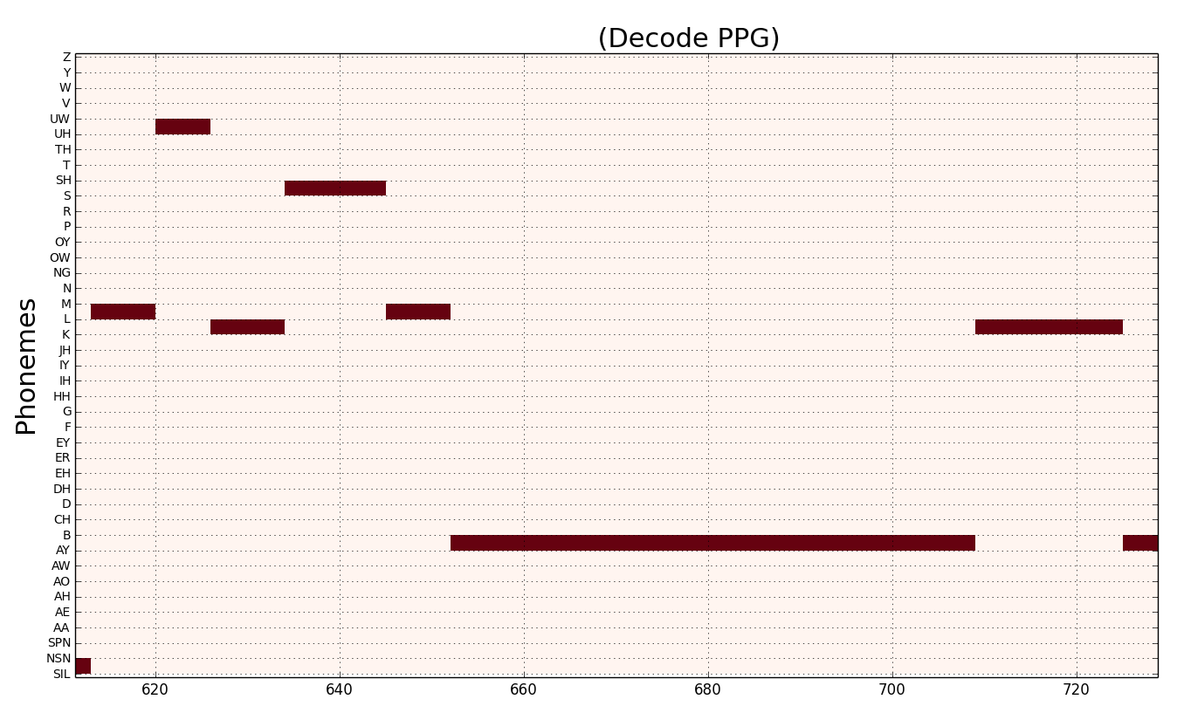
Scoring – Phonetic Posteriorgrams (PPG)
Sound & Music Computing Lab
http://www.smcnus.org/
UW
S
L
K
L
K
AY
looks
like
Frames
Notes:
PPG contains the normalized posterior probability of every
phone per frame, obtained from decoding a sung utterance
with the singing-adapted acoustic models

Slide 55
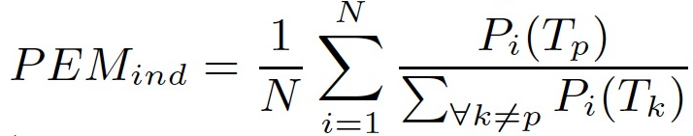
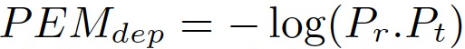
Scoring – Pronun. Eval. Metric (PEM)
Sound & Music Computing Lab
http://www.smcnus.org/
(1) Template independent PEM score indicates how close the pronunciation of a test sung utterance is to the target lyrics
A high score means the uttered phone is close to the target phone
(2) Template dependent PEM score indicates how close the pronunciation of a test sung utterance is to a reference sung utterance
If the reference and the test probabilities match, PEM will be small
Notes:
Template indep PEM is defined as the ratio of the probability of the target phoneme to the sum of probabilities of the rest of the phonemes, averaged over all the frames within the phoneme.
Template dependent PEM is computed as the dot product of the reference PPG vector Pr and the test PPG vector Pt

Slide 56
Word-level Scoring Validation Experiment
Sound & Music Computing Lab
http://www.smcnus.org/
Data: 990 words across 100 utterances: 10 sung utterances from 10 singers,
(5 from EN zone, and 5 from non-EN zone) (Smule’s DAMP Karaoke dataset)
Ground-truth: binary pronunciation judgment per word by two university students fluent in English
Method: Template- | Accuracy | FPR | FNR
Dependent | 0.52 | 0.48 | 0.47
Independent (LEX) | 0.72 | 0.28 | 0.28
Independent (w/o LEX) | 0.70 | 0.30 | 0.30
Notes:
Template indep PEM is defined as the ratio of the probability of the target phoneme to the sum of probabilities of the rest of the phonemes, averaged over all the frames within the phoneme.
Template dependent PEM is computed as the dot product of the reference PPG vector Pr and the test PPG vector Pt

Slide 57
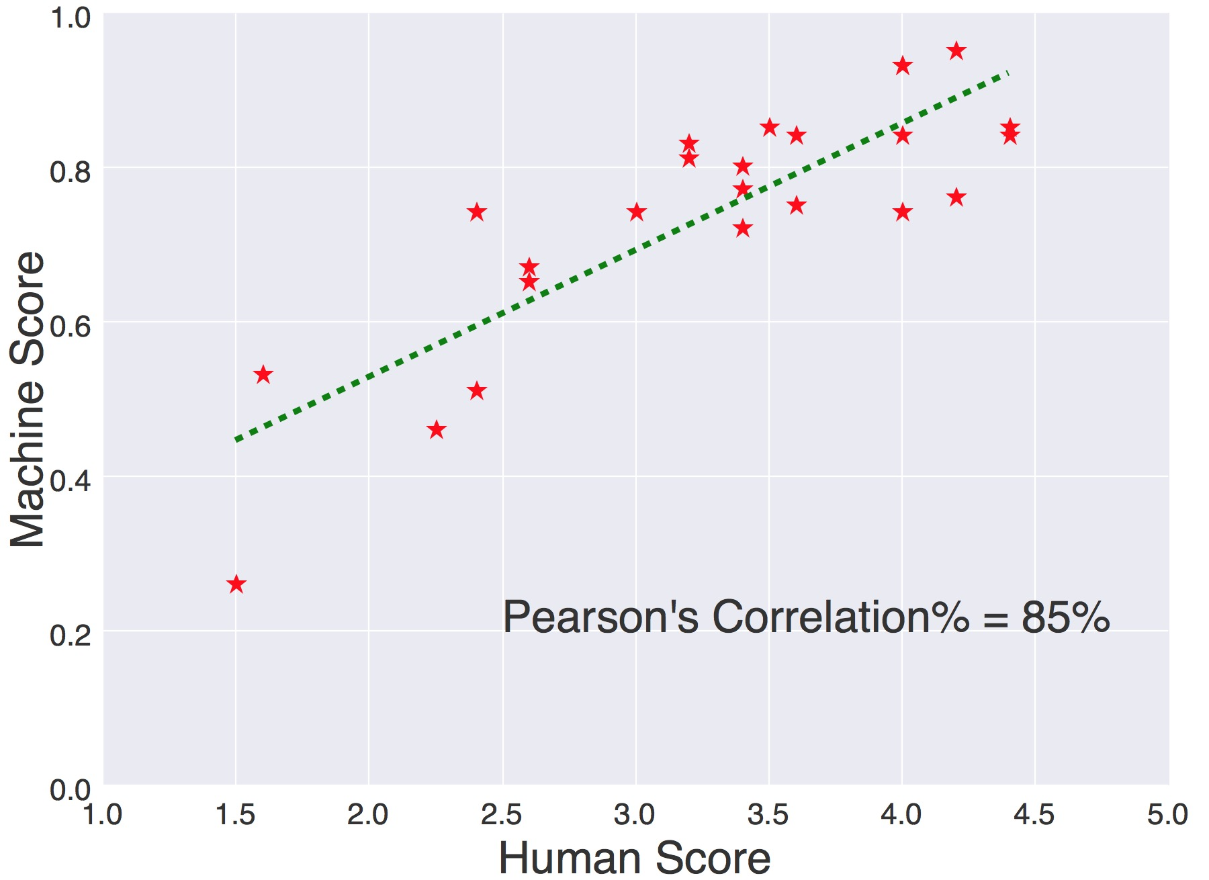
Song-level Scoring Validation Experiment
Sound & Music Computing Lab
http://www.smcnus.org/
Data: 24 singers (Smule’s DAMP Karaoke dataset) (13 female, 11 male) each singing one of 6 unique English popular songs. The singers belonged to different language speaking zones of the world: Japanese, Chinese, Spanish, French, and English
Ground-truth: Average song-level pronunciation judgments (over 5 raters) from crowd-sourcing platform Mturk. Correlation with lab experiment = 0.86.
Notes:
Template indep PEM is defined as the ratio of the probability of the target phoneme to the sum of probabilities of the rest of the phonemes, averaged over all the frames within the phoneme.
Template dependent PEM is computed as the dot product of the reference PPG vector Pr and the test PPG vector Pt

Slide 58
Thesis overview
Sound & Music Computing Lab
GOAL: Design and investigate objective techniques to model singing voice, and characterize and assess singing quality
Singing Quality Evaluation
Prosody
Pronunciation
☑
☑
Phonetic modeling of singing voice
Application 1: Pronunciation Evaluation
Application 2: Lyrics-to-audio alignment
Reference-dependent
Reference-independent
☑
☑

Slide 59
(C) Automatic lyrics-to-audio alignment on polyphonic music
Sound & Music Computing Lab
http://www.smcnus.org/
Given audio signal of singing voice and corresponding textual lyrics as input data, lyrics-to-audio alignment can be defined as a problem of estimating the temporal relationship between them
Applications: automatic generation of karaoke lyrics, song-browsing by lyrics, and the generation of audio thumbnails

Slide 60
General framework
Sound & Music Computing Lab
http://www.smcnus.org/
Trained acoustic models
Challenge:
Lack of availability of large lyrics annotated audio dataset to train acoustic model
Audio signal
Forced Alignment
Word Boundary timestamps
Lyrics
Kruspe^{[1]} and Dzhambazov^{[2]} used solo-singing DAMP dataset for training singing acoustic models (MIREX2017), but did not account for bad audio recordings and refinement of training data
[1] Anna M Kruspe, “Bootstrapping a system for phoneme recog-nition and keyword spotting in unaccompanied singing,” in ISMIR, 2016, pp. 358–364.
[2] Georgi Bogomilov Dzhambazov and Xavier Serra, “Modeling of phoneme durations for alignment between polyphonic audioand lyrics,” in 12th Sound and Music Computing Conference,2015, pp. 281–286

Slide 61
Our strategy
Sound & Music Computing Lab
http://www.smcnus.org/
Our singing-adapted models: WER=30% in a free-decoding experiment on solo-singing
But, these models do not perform well in the presence of background music ➔ training and test data mismatch
(a) train with polyphonic
(b) make test data closer to solo-singing trained models
☑

Slide 62
Results
Sound & Music Computing Lab
http://www.smcnus.org/
Average absolute word boundary error (seconds)
Polyphonic data
Hansen’s: 9 English pop songs,
Mauch’s: 20 English pop songs
Dataset | Sing-adapted ASR + |  |  |  | MIREX 2017 best | KKBOX Inc. (MIREX 2018 best)
 | No source sep | ^{[1]}Harmonic/Percussive | ^{[2]}CNN-based | ^{[3]}U-Net based
Hansen’s | 18.78 | 20.69 | 3.14 | 1.39 | 7.34 | 2.07
Mauch’s | 25.42 | 25.83 | 17.74 | 6.34 | 9.03 | 4.13
[1] Derry Fitzgerald, “Harmonic/percussive separation using me-dian filtering,” in3th International Conference on Digital Au-dio Effects (DAFX10), Graz, Austria. 2010, Dublin Institute ofTechnology
[2] Pritish Chandna, Marius Miron, Jordi Janer, and EmiliaG ́omez,“Monoaural audio source separation using deepconvolutional neural networks,” inInternational Conferenceon Latent Variable Analysis and Signal Separation. Springer,2017, pp. 258–266
[3] Andreas Jansson, Eric J. Humphrey, Nicola Montecchio,Rachel M. Bittner, Aparna Kumar, and Tillman Weyde,“Singing voice separation with deep U-Net convolutional net-works,” in ISMIR, 2017
Notes:
[1] Derry Fitzgerald, “Harmonic/percussive separation using me-dian filtering,” in3th International Conference on Digital Au-dio Effects (DAFX10), Graz, Austria. 2010, Dublin Institute ofTechnology
[2] Pritish Chandna, Marius Miron, Jordi Janer, and EmiliaG ́omez,“Monoaural audio source separation using deepconvolutional neural networks,” inInternational Conferenceon Latent Variable Analysis and Signal Separation. Springer,2017, pp. 258–266
[3] Andreas Jansson, Eric J. Humphrey, Nicola Montecchio,Rachel M. Bittner, Aparna Kumar, and Tillman Weyde,“Singing voice separation with deep U-Net convolutional net-works,” inISMIR, 2017

Slide 63
Application: Lyrics-to-Polyphonic Audio Alignment
Sound & Music Computing Lab
http://www.smcnus.org/
Mean average absolute boundary error (seconds)
Database | SingASR | SingASR + U-Net source sep. | MIREX2018 best | MIREX2017 best
Hansen’s | 18.78 | 1.39 | 2.07 | 7.34
Mauch’s | 25.42 | 6.34 | 4.13 | 9.03
[1] Andreas Jansson, Eric J. Humphrey, Nicola Montecchio, Rachel M. Bittner, Aparna Kumar, and Tillman Weyde,“Singing voice separation with deep U-Net convolutional net-works,” in ISMIR, 2017

Slide 64
Sound & Music Computing Lab
Contributions
a strategy for obtaining large-scale singing-lyrics annotated dataset to train singing-adapted speech acoustic models
a strategy of duration-based lexicon modification to improve the performance of the singing-adapted speech acoustic models
incorporating these modified acoustic models results in better word boundary alignment, recognition, and pronunciation assessment in singing voice
Publications
Chitralekha Gupta, Rong Tong, Haizhou Li, and Ye Wang, “Semi-supervised lyrics and solo-singing alignment”, In Proceedings of International Society of Music Information Retrieval (ISMIR), Paris, 2018.
Chitralekha Gupta, David Grunberg, Preeti Rao, and Ye Wang, “Towards Automatic Mispronunciation Detection in Singing”, In Proceedings of International Society of Music Information Retrieval (ISMIR), Suzhou, 2017.
Chitralekha Gupta, Haizhou Li, and Ye Wang, “Automatic Pronunciation Evaluation of Singing”, In Proceedings of Interspeech, Hyderabad, 2018.
Chitralekha Gupta*, Bidisha Sharma*, Haizhou Li, and Ye Wang, “Automatic Lyrics-to-Audio Alignment on Polyphonic Music Using Singing-Adapted Acoustic Models”, In Proceedings of ICASSP, 2019. (*equal contributors)

Slide 65
Summary
Sound & Music Computing Lab
Designed and investigated objective techniques to model singing voice, and characterize and assess singing quality
Singing Quality Evaluation
Prosody
Pronunciation
☑
☑
Phonetic modeling of singing voice
Application 1: Pronunciation Evaluation
Application 2: Lyrics-to-audio alignment
Reference-dependent
Reference-independent
☑
☑
☑

Slide 66
Open problems
Sound & Music Computing Lab
http://www.smcnus.org/
The adaptation of singing-acoustic models for language learning and speech therapy application needs to be further explored
Generalizability of our singing quality evaluation measures to other music genres and styles needs to be investigated in the future
Improvement of performance all methods in polyphonic audio

Slide 67
Sound & Music Computing Lab
http://www.smcnus.org/
THANK YOU! ☺
QUESTIONS?

Slide 68
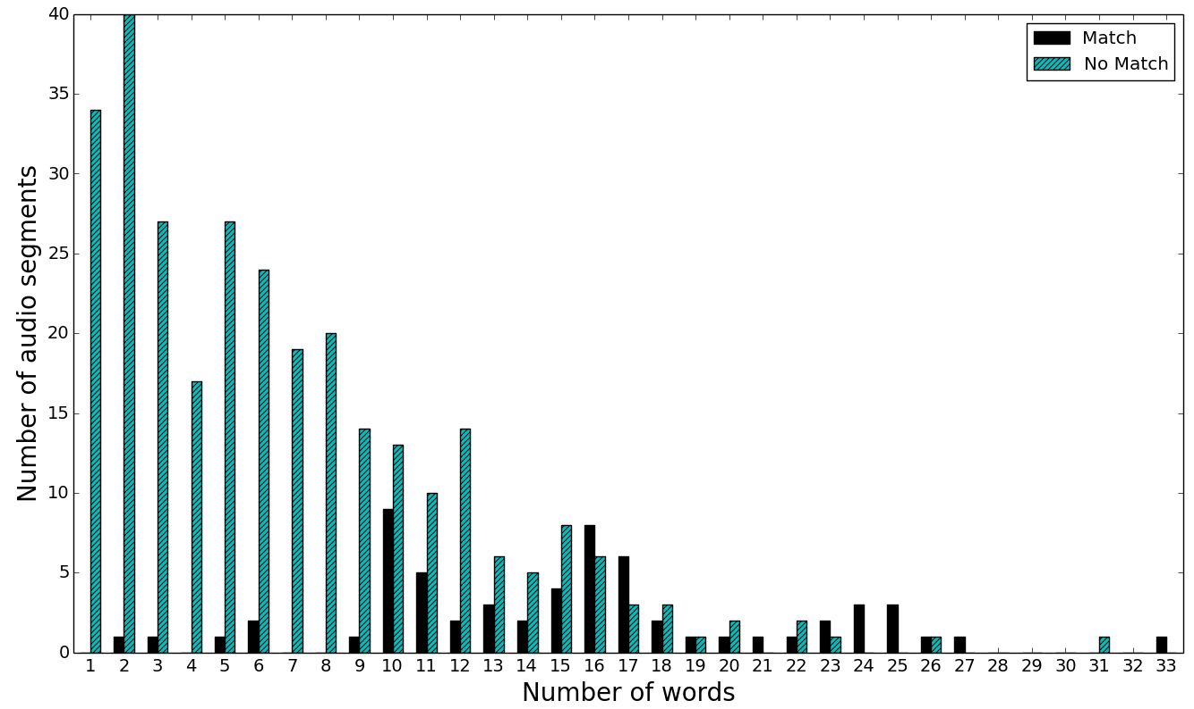
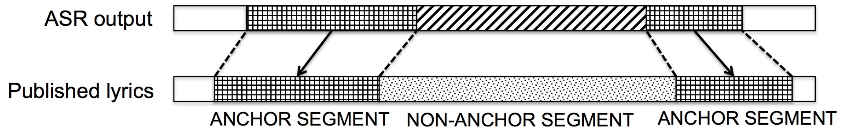
Choosing more reliable or anchor segments
Sound & Music Computing Lab
http://www.smcnus.org/
anchor segments

Slide 69
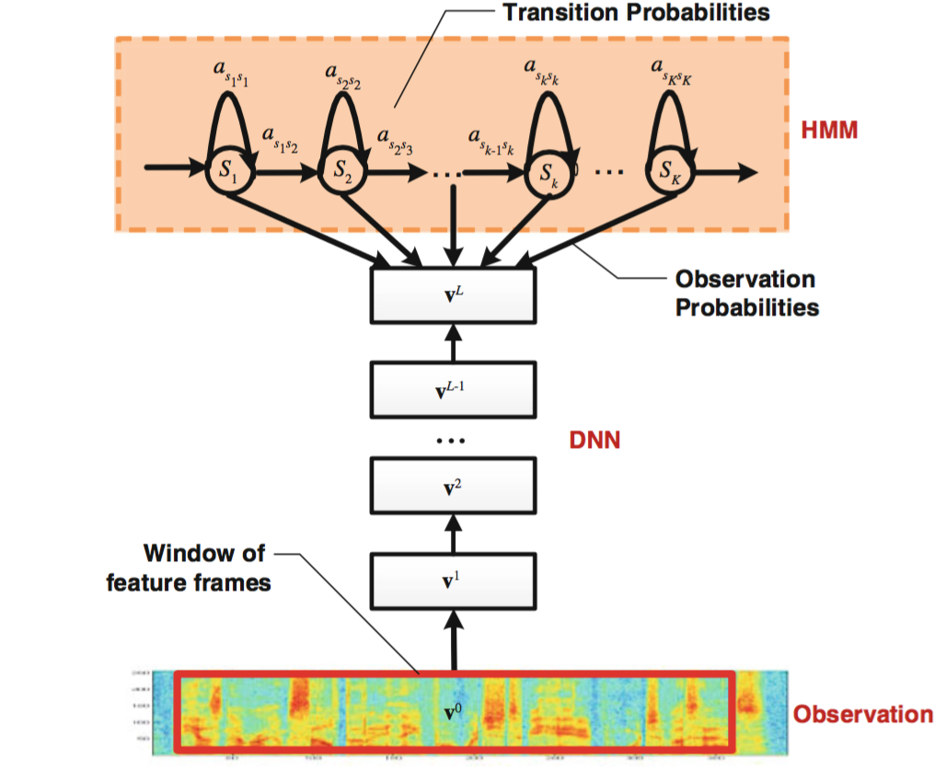
DNN-HMM Hybrid architecture in ASR
Captures variable length property of speech
Discriminative/Classification ability
^{[1]} Yu, Dong, and Li Deng. Automatic speech recognition: A deep learning approach. Springer, 2015.
Notes:
speech signals are essentially time series signals, which can have variable lengths. For eg. The phone /aa/ can be spoken as /aa/ or /aaaa/, but still remains the phoneme /aa/.
This variable length property is captured by Hidden markov model, that consists of a sequence of states, with transition probability and state likelihood or the observation probability.
The DNN is a stack of non-linear hidden layers, whose output neurons are trained to estimate the posterior probability of the states, given the acoustic observation vector.
The cross-entropy between ground-truth targets and the posteriors is often used as an optimization criterion for DNN training

